Slide 1
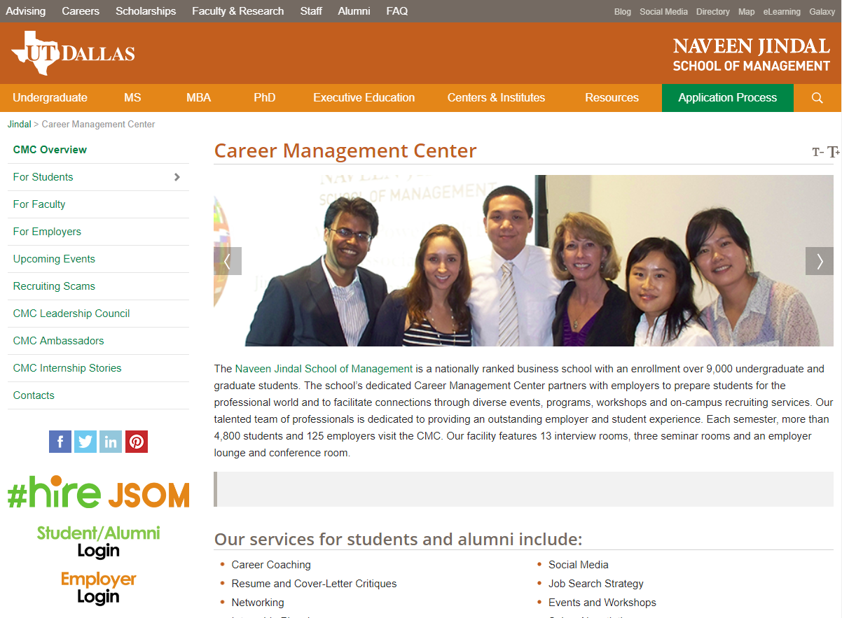
Using Perfect Interview
1. Go to the Career Management Website
It can be accessed at http://jindal.utdallas.edu/career-management-center/ or by googling “UTD Career Management Center”

Slide 2
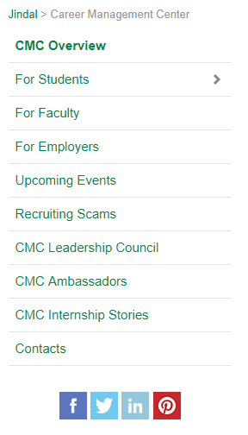
2. Click on “For Students”
Using Perfect Interview

Slide 3
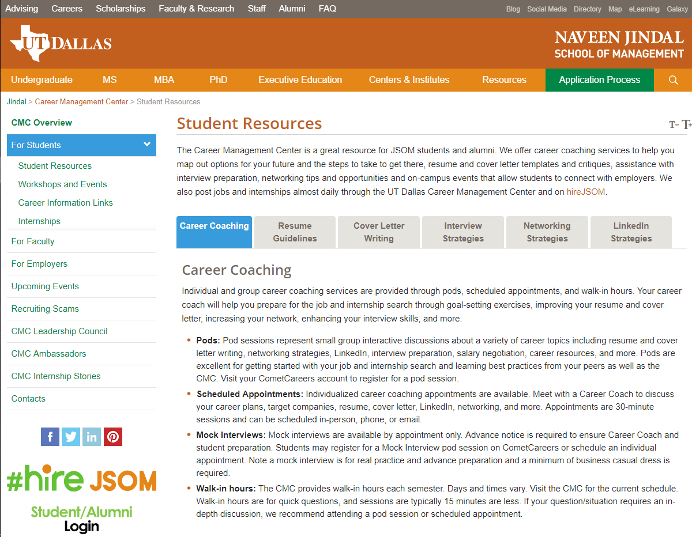
3. Click on “Career Information Links”
Using Perfect Interview

Slide 4
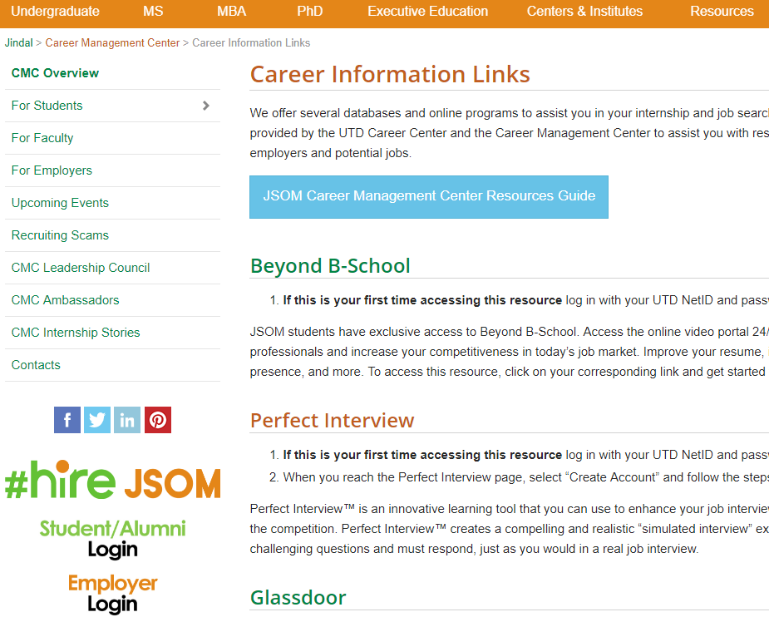
4. Click on “Perfect Interview”
Using Perfect Interview

Slide 5
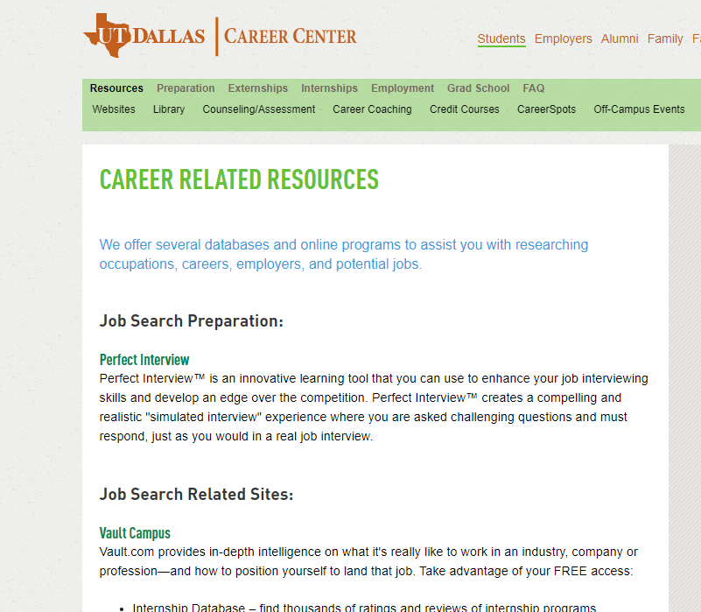
5. Click on “Perfect Interview” again
Using Perfect Interview

Slide 6
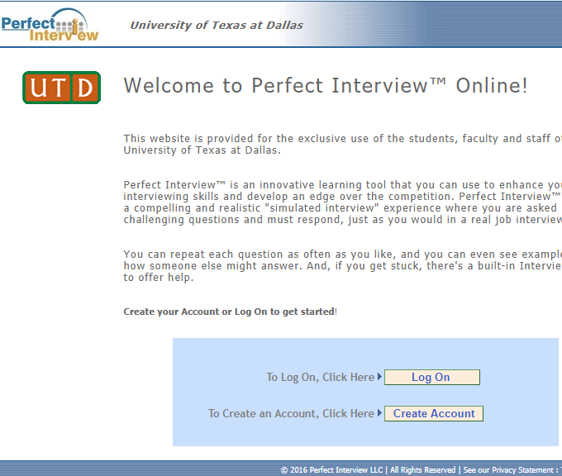
6. Click on “Create Account”
Using Perfect Interview

Slide 7
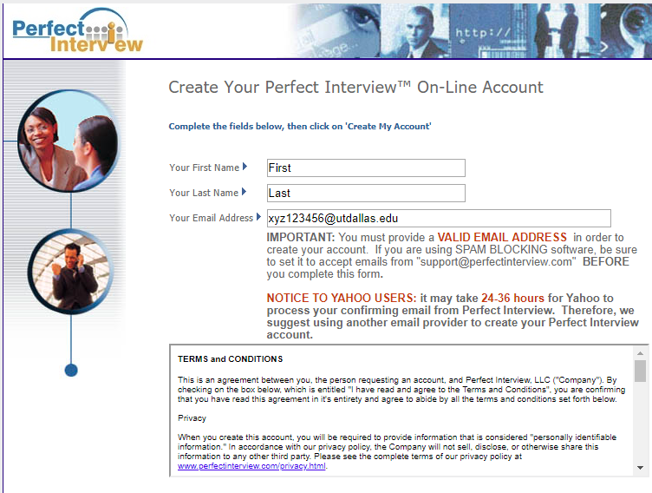
7. Enter your information Use your Net ID followed by @utdallas.edu for your email address.
Using Perfect Interview

Slide 8
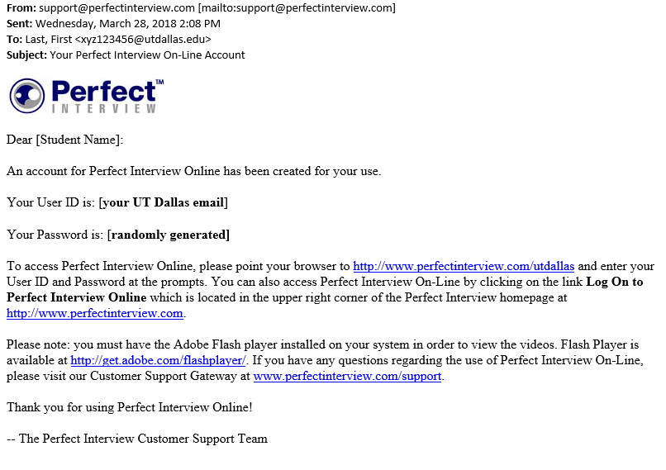
8. Check your UTD email to get your User ID and password
Using Perfect Interview

Slide 9
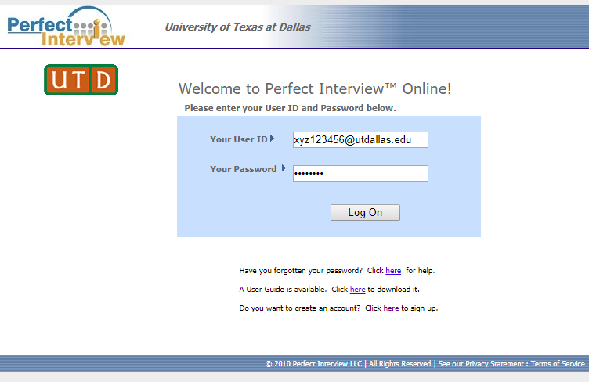
9. Login with given username and password
Using Perfect Interview

Slide 10
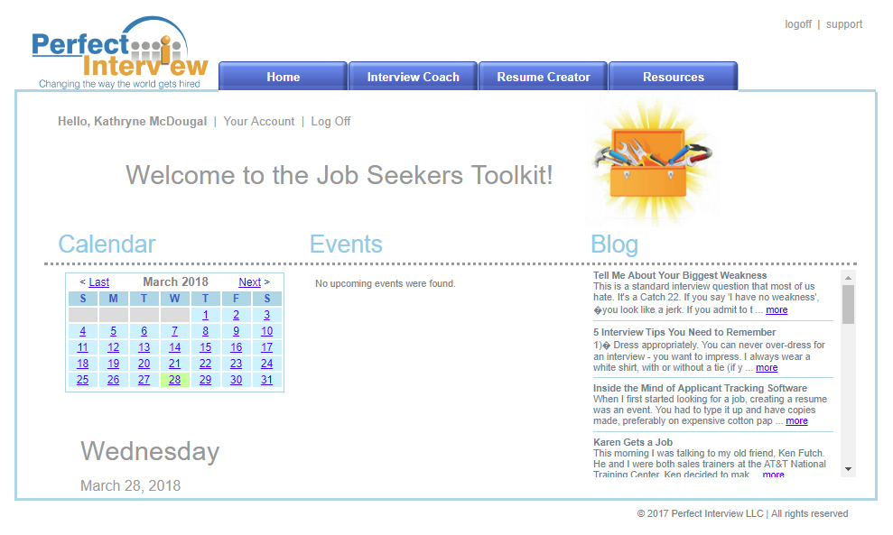
10. Click on “Interview Coach” tab
Using Perfect Interview

Slide 11
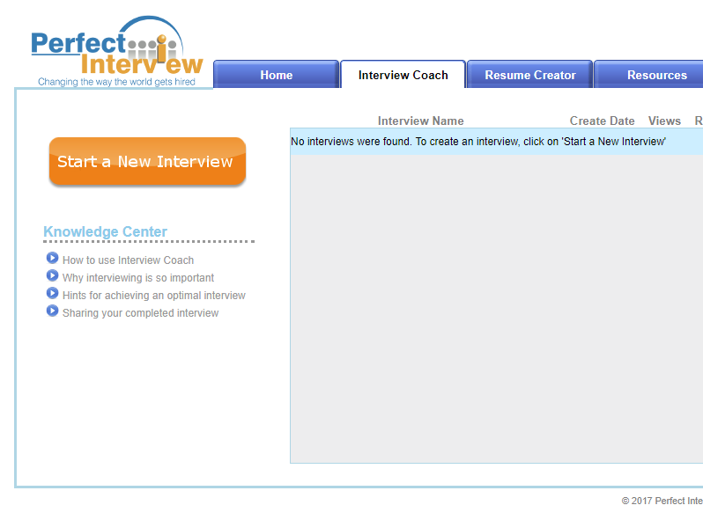
11. Click on “Start a New Interview”
Using Perfect Interview

Slide 12
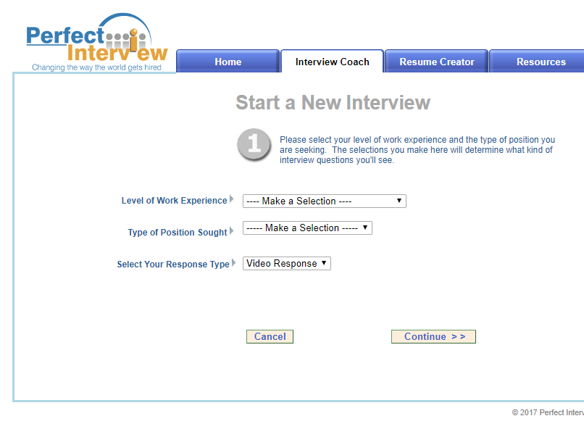
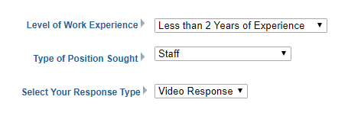
12. Make selections according to provided instructions Click on Continue to advance to the next set of selection criteria.
Using Perfect Interview

Slide 13
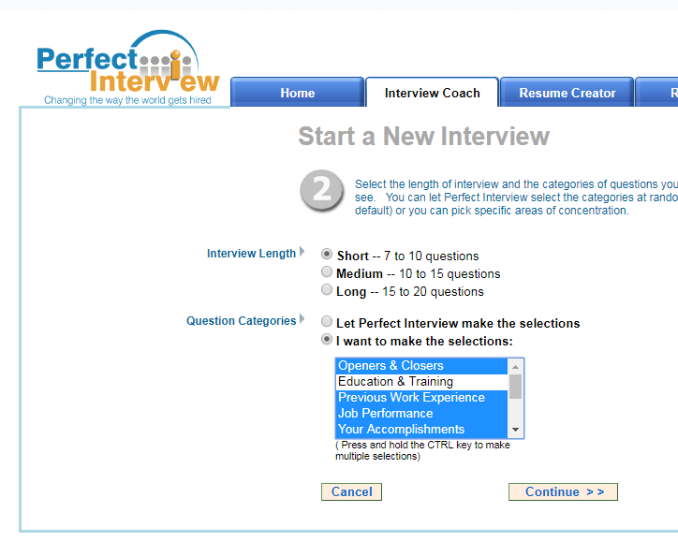
13. Choose the Short Interview option and select the following Question Categories by pressing the Ctrl key and clicking on each: - Openers & Closers - Previous Work Experience - Job Performance - Your Accomplishments - Your Qualifications .
Using Perfect Interview

Slide 14
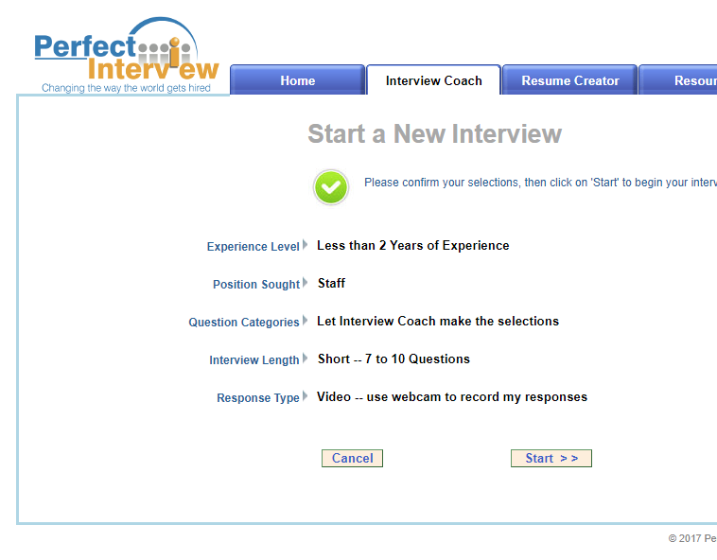
14. Click “Start Interview” and you are ready! Make sure you enable Adobe Flash player
Using Perfect Interview

Slide 15
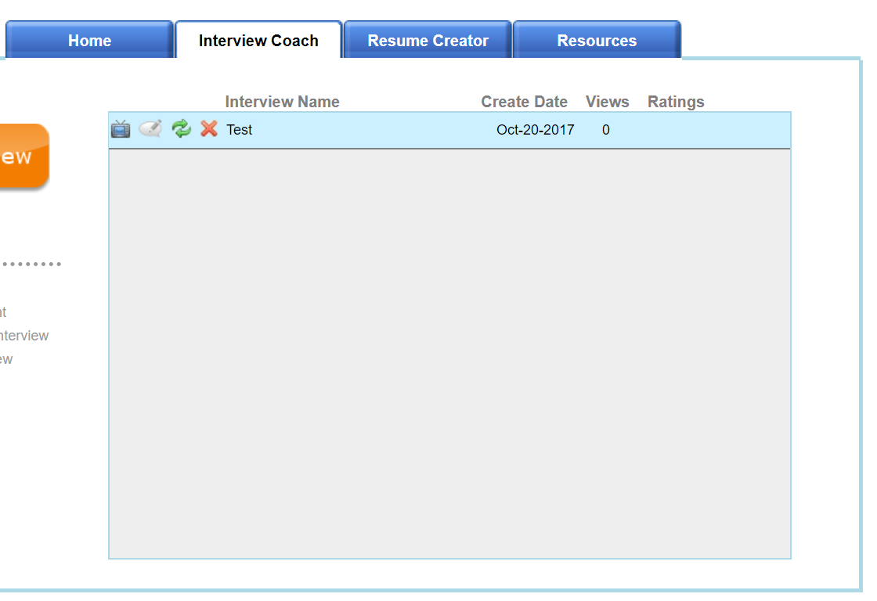
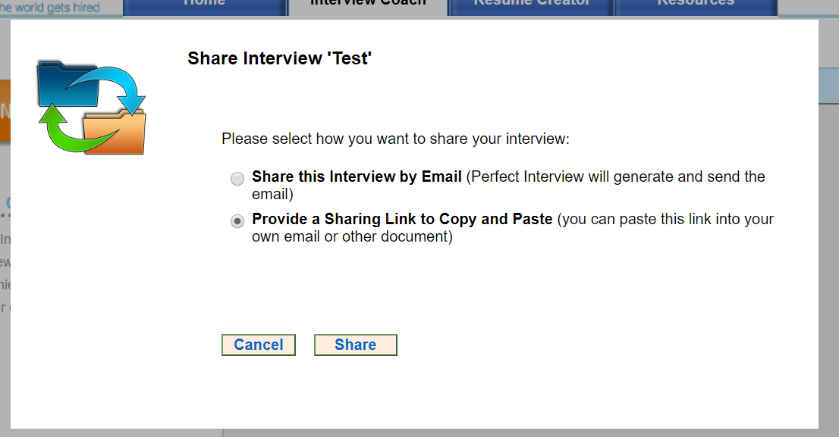
15. Once you complete and save your interview, you’ll see it listed under the Interview Coach tab. Click the green circular arrows to share your file. A popup window will open. Choose Provide a Sharing Link and click Share.
Using Perfect Interview
Susan Brookshire

Slide 16
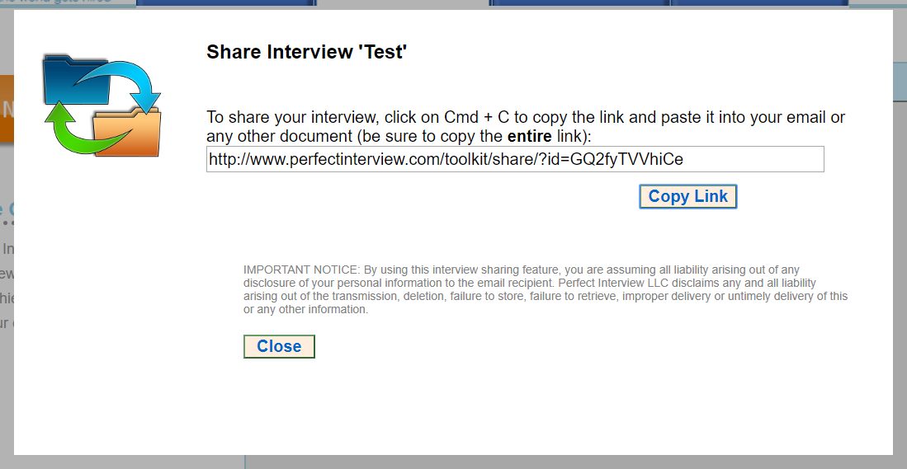
16. Copy the link and send it to your partner in an email. You will also upload this link in e-learning to fulfill the Perfect Interview assignment.
Using Perfect Interview

Slide 17
Interview Practice Assignment
Using Perfect Interview to record one simulated interview.
Recent College Graduate
Staff Level
Video Response
Short Interview
Question Categories choose: Openers & Closers, Previous Work Experience, Job Performance, Your Accomplishments, Your Qualifications
Complete the interview questions
Save the interview session
Click on the green arrows to share your file with your partner
Review your partners interview session. Use Feedback Form in Week 9 Course Materials to provide feedback.
Print a copy of the feedback form and bring to class Week 13
Submit your video file link and a copy of the review form you completed for your partner via e-learning
Notes:
eLearning Template

